Slide 1


Monthly Meeting #2
Masters meeting
- February 6th , 2019-
Opening
Pause Our Method How to join our Tribe?
Master, L.4
Online Course

Slide 2


Today’s Session
Today’s Session
Content from:

Slide 3
Today’s Session
Today’s Session
Opening: Hello, Pause, Agenda (15 min.)
Introduction to POY content (5 min.)
Opening, Pause, Our Method Preparations
How to join our Tribe? Facilitation content
Professional content (60 min.)
Questions (30 min.)
Closure (10 min.)

Slide 4
Introduction to POY content
What will you teach through this content?
1. The setting and the workshop framework
Guidelines and group agreement for a healthy group relationship, modeling
2. Pause
As Points of You ® way of life and Method
3. Points of You® Method
Learn the 4 simple steps of our unique method. 4. How to join our Tribe Information about Points of You ® Academy (L.1-L.4)
Clarity about the requirements to become Experts

Slide 5
About this guide
- Red -
Preparation
Everything you will need to prepare
for the workshop in general
and for each process in particular.
- Blue -
Points of You facilitation method
Facilitator's Focus points
Facilitation Notes
- Black & White –
Facilitation Content
These parts will take you through the workshop step by step.

Slide 6
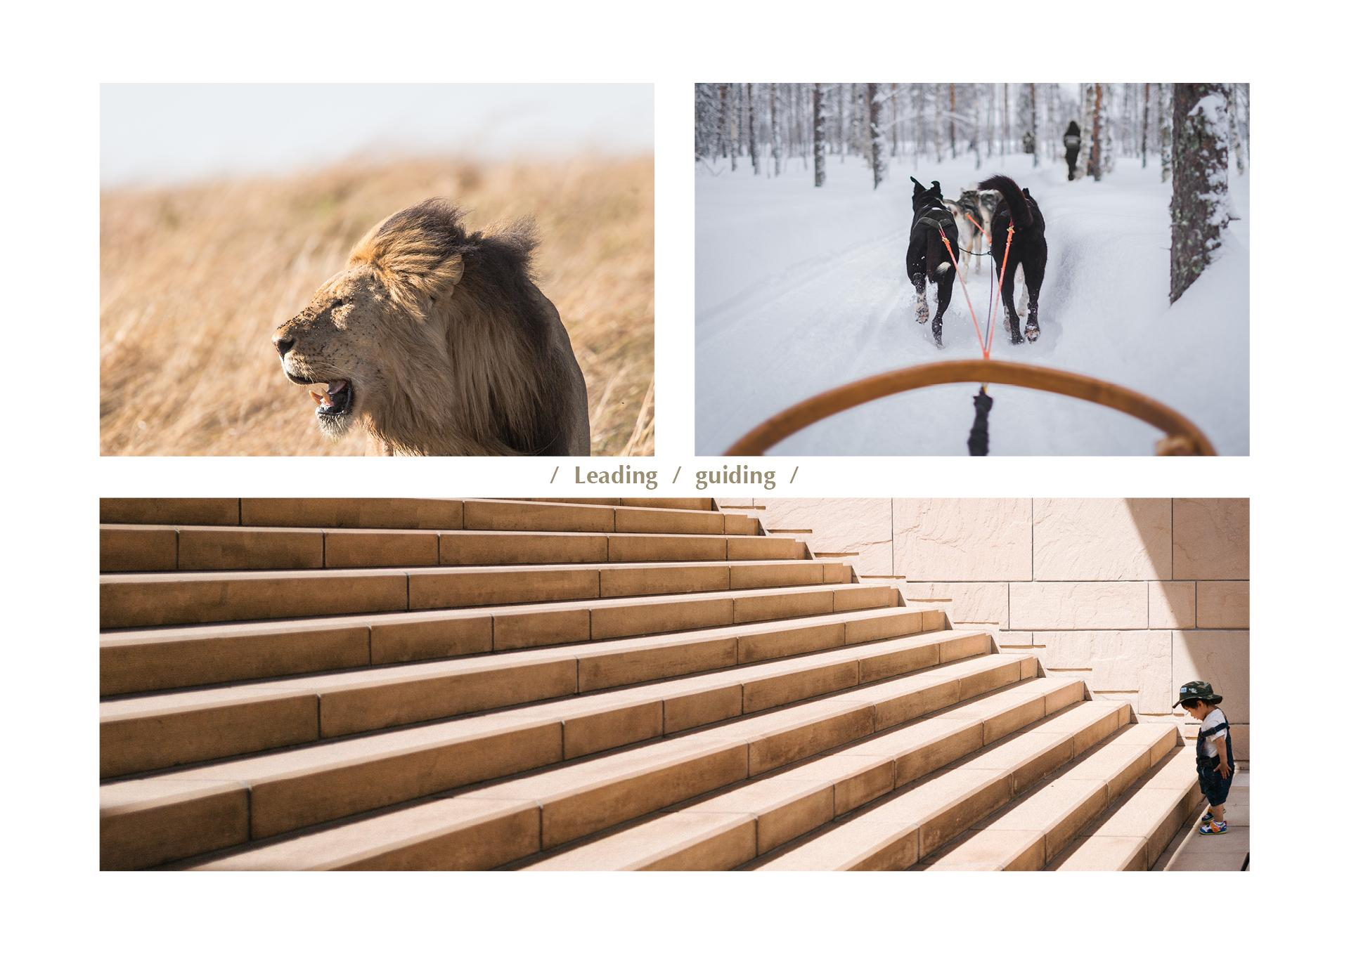
Facilitation
Orientation in the Agenda
Day 2
12:30-12:45 Our tools Led by a 3rd time Helper 12:45-13:30 Our D.N.A. Led by the lead Facilitator
Day 3
17:30 - 18:00 Our method Led by the lead Facilitator

Slide 7
Facilitation
Orientation in the Agenda
Day 1
Welcome Led by Initiator/the lead Facilitator
15:00-15:45 Opening Led by the lead Facilitator 15:55-16:15 Pause Led by the lead Facilitator
Day 4
17:30 - 18:00 Our method Led by the lead Facilitator
18:30-19:00 How to be part of our Tribe? 2nd time Helper

Slide 8
Facilitation
Welcome
Welcome and Hello TPP #______ (excitement!!!)
Devotion to the process
Clean destructions
Introduction: Initiator, Facilitator, Helpers (name and where from)
Logistics
14:45- Open doors
ENJOY! Welcome to Points of You ® family <3
Welcome opening
Notes:
Welcome (say it in the local language), my name is __________ and I'm one of the Maters facilitators in Points of You team.
 Finally, it is happening!! I am so excited!
 Thank you for making the effort => I promise you that it will pay off.
 We are here _____(number) countries (say as much names of the countries as you can)
 We will work with translation (in countries we do).
Devotion to the process
 This is a magical place, each one of you is going to feel this magic on the right timing for you=> I promise you it will happen.
 This is a deep, powerful, unexpected, life changing process.  All of you are professionals- this is your turn and time to receive, to grow, to be held by someone else, we invite to go back to your student state of mind.
 We are going to challenge you with a lot of love, if we want to have the change that we are wishing for- it begin- when we leave our comfort zone behind!!
we want to ask you to put your judgement and your expectation aside.  This journey is going to be both personal and professional.
 Let yourselves become devoted to this journey, Trust the process! Clean destructions-  In the last few years we grew enormously, and we are entering to a new model we’ve build of Points of You ® Academy.
 Along with this breakthrough we've realized that Efrat & Yaron cannot do it on their own anymore, and we’ve recruited a strong team of Masters.
 We are going to work in 2 groups, and each group will be led by one of our most experienced facilitators, who are both doing a long way with us: ______& ______(Mention the names of the facilitators and where they're from).
 (If you are the initiator): I will not be facilitating this workshop, my role this time is
mainly to initiate ________ (the name of the facilitator).
 Helping role in this workshop. They are doing an amazing work, and there is A LOT of work behind the scenes that you are not even aware of!
These are our Helpers: _______ (introduce them name + where they're from)!!!
Logistics- Room and roommates, In case of 2 groups – which participants are in the group, Work space (where), Lunch (where& when), Check-in (when), 14:45 WE ARE STARTING.

Slide 9
Facilitation
Opening
(45 minutes)
Preparation
Music
Music for the entrance (Playlist 1) Music for the Pause (Playlist 2)
Room setting The chairs are organized in a circle, with the participant’s bags
Centerpiece with the Coaching Game cards & Refresh, face down
Tools & Facilities Facilitators booklet- to read the bullets of the opening
Participant’s booklet
(last version page
Notes:
Entrance music (Playlist 1)- Apple Music: https://itunes.apple.com/il/playlist/entering-tcp/pl.u-WabZl5Afvy13b7 Spotify: https://open.spotify.com/playlist/2AU42UA3ckAqupgiKdF83S
Pause music (Playlist 2)- Apple music: https://itunes.apple.com/il/playlist/beginning-pause-tcp/pl.u-KVXBq0VCm9bM8J
Spotify: https://open.spotify.com/user/sezinhason/playlist/6CFjZ6u8WvNHwihkY2G6J9?si=-2fnh38cQrCOSN-y-KLF2w

Slide 10
Facilitation
Opening
(45 minutes)
Facilitator’s focus
To get the participants into the process
To agree on group contract: Sensitivity and respect
To establish the setting of the workshop
To create enthusiasm in the process - PR
To inspire and lead as a facilitator
Facilitator’s notes
This is where you take leadership over the room
Make the opening exciting and inspiring Facilitator’s role: a leader, a parent, a container
Notes:
To get the participants into the process- Make the participants feel committed, engaged to the process.
PR- the workshop, talk with enthusiasm , stand, bring yourself and your personal qualities. If you are not authentic and inspiring the participants will feel it. They came to see you and this is the time to deliver in one minute. This is the money time, if you are leaders of the group or not.

Slide 11
Facilitation
Opening
Facilitation Content
Welcome & opening
Turning Point Program- objectives
Sensitivity & Respect
Guiding points (logistics)
Pause
Notes:
Guiding points (logistics)- You can say shortly where is the toilets, smoking area…

Slide 12
Facilitation
Opening
Facilitation Content
Welcome & opening
Welcome and team introduction
This workshop if focused on HOW TO through experience
What we are doing in POY by expending the Point of view (Open people’s hearts, break patterns, give a sense of belonging)
We will wear two hats ( a professional upgrade & a personal journey)
We will Create and present our own workshop using the tools
Logistics (meals, room & facilities, schedule & agenda, booklets)

Slide 13
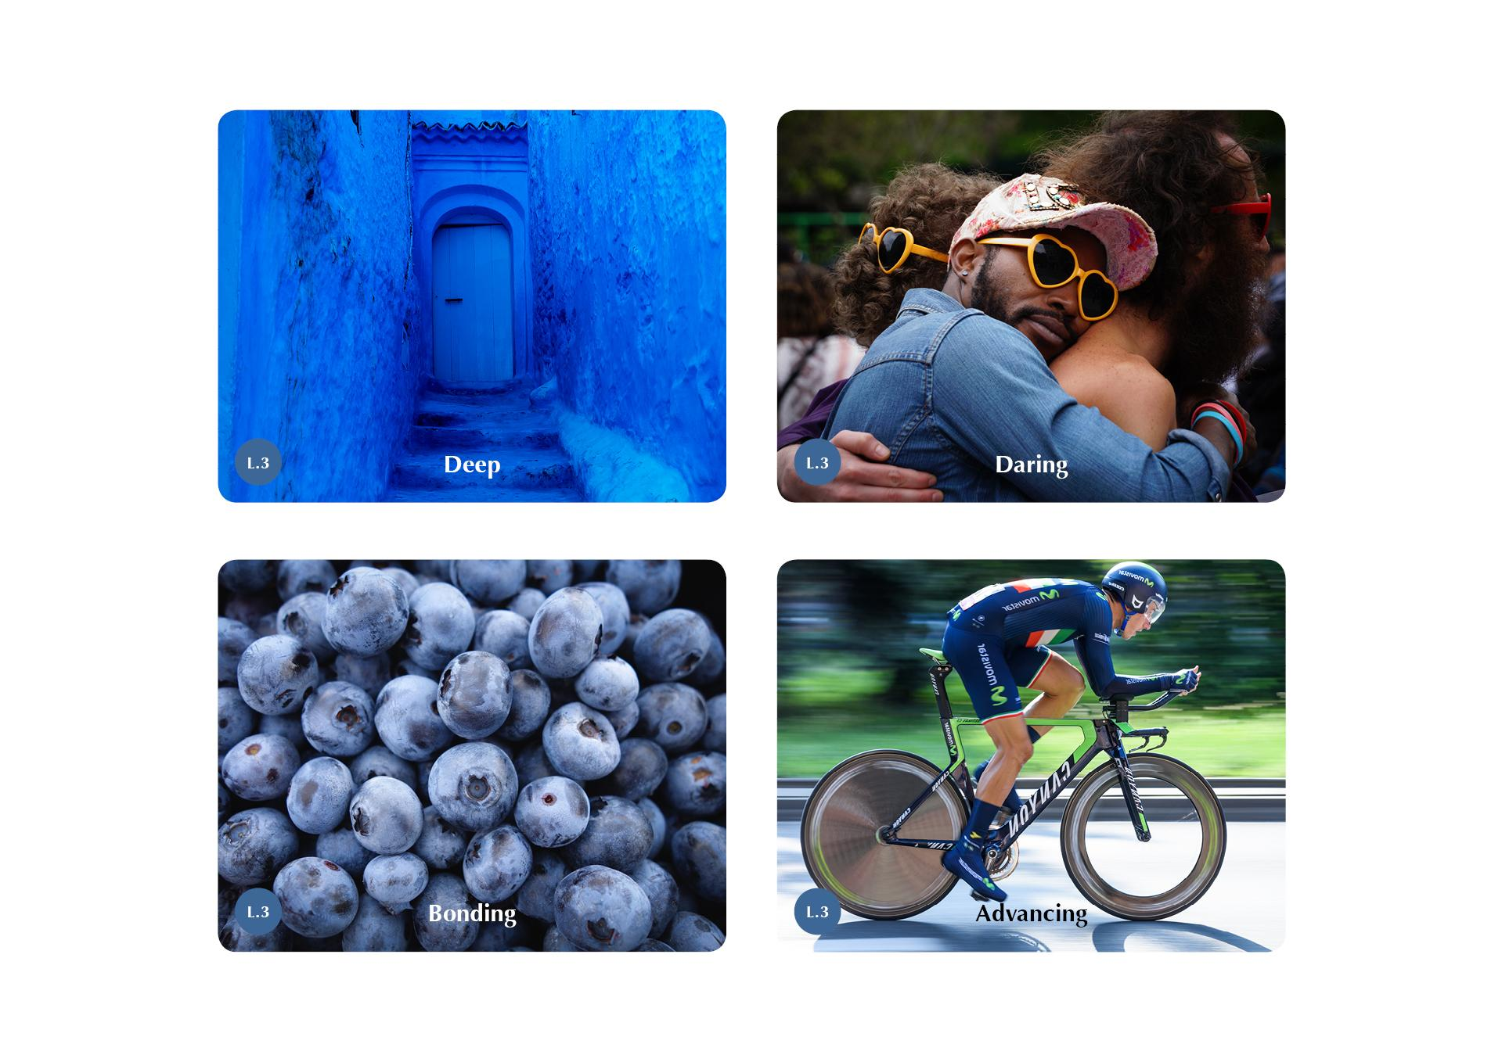
Facilitation
Opening
Turning Point Program- objectives
1. Deep
Dive in deep into your personal process

Slide 14
Facilitation
Opening
Turning Point Program- objectives
2. Daring
Dare to express yourself fully, to break your patterns and to dream big.

Slide 15
Facilitation
Opening
Turning Point Program- objectives
3. Bonding
Allow yourself to feel belong

Slide 16
Facilitation
Opening
Turning Point Program- objectives
4. Advancing
Upgrade your professional tool kit and skills

Slide 17
Facilitation
Opening
Sensitivity & Respect
Safety net
No Judgement, No expectations
Be on time
What said stays in the room Respect other’s journey
Flight mode in public places
I statements
Raise hands for agreement
Notes:
Safety net This is our group contract, we are not calling it like that, but the meaning is to make you feel in a safe place, and to build our safety net in the group. Be on time- according to clock but also in the process. I recommend to arrive 10 minutes before and do the transition more smoothly. If somebody is not here I am not going to start, so it is your responsibility to be on time because everyone is going to wait for you. Be on time is a state of mind, it is not only the clock. Timing in life is everything. When we are on time everything happens in the right timing.
We know when we start but we don’t know when we will end. Sometimes, there are things that happening in a group that we cannot calculate, like give to someone more space that he/she needs.
What said in here stays here in this room - This is the way we are building our safety net. Of course you can share the experience with others outside – but only about yourself. We want to invite you to feel free, confidence to express yourself to the max, and to be able to share with the group even your most gentle things. When we are saying “sharing out” it includes social media like Facebook, Instagram etc. Please ask for permission if you want to upload someone's picture. We have our close group on Facebook, you can upload there. No one will see It, except us, or in our WhatsApp group. Respect other’s journey- As much as you will share in this group you will gain more. When someone is speaking, do not go into their words. Listen with sensitivity. Give others the space and don't interrupt because it might be the moment of their breakthrough. If you need to go out, do it after someone finished and before someone else started. We want your 100% presence here. I would appreciate it if during the sessions you will stay in the room and not take small breaks. But of course, if you must, you must. Be aware of when you must go out. You don't need to share it with us. Ask yourself why do you need to go out/ drink right now/ go to the toilet? As much that you will be here it will serve you more.
Flight mode- Smartphones as communication device are not allowed in any of the public spaces (workshop rooms, dining room, even in your accommodation ask your partner’s permission). The smartphone is part of us, and here we are trying to break a pattern, even an addiction. It is not easy. Use it only as a camera. We will be strict about it. Inside the room - no phones are allowed at all. Flight mode. No SMS, no anything. Let’s give ourselves a chance to break this pattern too. Let's go in instead of going out.
I Statement- we are going to share ourselves. Does anyone want to add something that is important for him ? Who agree?
Raise your hand to get the approval of agreement. Check that everybody in the room are raising their hands. Good, flight mode- now.
We will use 2 very unique tools for going deeper and for gaining additional different perspectives:

Slide 18
Facilitation
Opening
Guiding points (logistics)
Breaks During the day
Workshop materials
Writing
Photography
Notes:
Breaks During the day – breakfast (7-9), lunch(13:30-16:00), dinner (1900-21:00), breaks for coffee in between.
Workshop materials – Participant’s kit, tools, their booklet and notebook Writing We gave you a Notebook that you can write in it. Communicate with yourselves by writing. Writing to myself is a great tool for going deeper into me. I want to invite you to write 3 pages to yourselves every morning. Don’t think too much. It is a great tool for a dialog. Think about it as a camera, whenever you want to capture something, write it down.
Photography Use a camera or your smartphone as a camera as much as you can. Try to capture significant moments for you, (it doesn’t matter why they are significant for you). Look at your photos at the end of every day. Taking a photo is framing our soul and emotions from our point of view If I will ask you all to take out your cameras right now and to take a photo of this room, we will get totally
different frames and points of views. Photography can expand our points of view especially about ourselves. At the end of the course I will ask you to upload a small gallery on our Facebook group , not more than 10 photos that will represent your journey here. Do it when you feel you are ready to give it to yourself. t is also nice to share it & to get some comments and perspective. Photography (and Emojis ) is the 21st century official global language , that we all speak. Who took a photograph today? Raise your hand- and give them the chance to answer that question by raising their hands.
This is the way we are communicating with others and with ourselves. In the past it was only in special occasions in the studio, with nice clothes, now it’s part of our life. Photography is a way we are delivering massages. Photography is a window to our soul. We are clicking the camera when we want to capture a very internal moment which we will be able to observe again in the future, or to share with others. Take as much as photos as you can. This is also part of the process. Just pay attention! the camera is also a tool for us to be observers and not to play in the Arena. It creates a screen between the world and us. Be aware of when you are running from the situation, it’s the same as we are running to our phones.

Slide 19
Facilitation
Pause (20 minutes)
Facilitator’s focus
To Tune in, take a breath and meet myself
To digest the opening
To get to know the Pause process as part of the Points of You® method
To start practicing inner research
Facilitator’s notes
The pause is for the participants and for you as facilitator
Stay still, keep calm, don't be reactive to what is happening during the Pause
(even if you feel movement or hear noises in the room)
Notes:
The pause is an opportunity to the participants who don’t know each other, and for you, to digest.
Close your eyes and trust the process. You are part of the group, sitting on the same chair, the only difference is that you sharing knowledge with the group.
Practice pause, don’t move, don’t respond to the movements. This is in every aspect in your life, not only in Points of You workshops.

Slide 20
Facilitation
Pause
Facilitation Content
In the 21st century, pausing is not allowed
How am I (Physically, feeling, thoughts)? 4 places of presence
An in- between time
At some point life will stop us
This is the first step for inner research
Gandhi story
A click on the camera- Pausing the moment
Pause music
Notes:
Pause music (Playlist 2)- Apple music: https://itunes.apple.com/il/playlist/beginning-pause-tcp/pl.u-KVXBq0VCm9bM8J
Spotify: https://open.spotify.com/user/sezinhason/playlist/6CFjZ6u8WvNHwihkY2G6J9?si=-2fnh38cQrCOSN-y-KLF2w

Slide 21
Facilitation
Our Method
(30 minutes)
Preparation
Music
None
Room setting This is after ‘on the stages’ process and we will organize the chairs back to a circle
Centerpiece with the ‘workshop cards’ (Why am I here)
Tools & Facilities 4 Method cards- which we hand to the participants Facilitators booklet- to read the 4 stages of our Method
Participant’s booklet
Our Method (page 72-73)

Slide 22
Facilitation
Our Method
(30 minutes)
Facilitator’s focus – The Method
To integrate their experience of our tools and trainings into a simple structure
To give a logic which they can use while working with our tools & the training
To teach the Points of You® Method
Facilitator’s notes
Points of You Method: Read, explain and give example

Slide 23
Facilitation
Our Method
(30 minutes)
Facilitation Content
Opening
objectives
Process flow
Points of You Method
Pause- Expanding- Focusing- Doing
Closure
We are continuing to the next session- ‘How to join us’

Slide 24
Facilitation
Our Method
(30 minutes)
Preparation
Music
None
Room setting This is after ‘on the stages’ process and we will organize the chairs back to a circle
Centerpiece with the ‘workshop cards’ (Why am I here)
Tools & Facilities 4 Method cards- which we hand to the participants Facilitators booklet- to read the 4 stages of our Method
Participant’s booklet
Our Method (page 72-73)

Slide 25
Facilitation
Our Method
(30 minutes)
Facilitator’s focus – The Method
To integrate their experience of our tools and trainings into a simple structure
To give a logic which they can use while working with our tools & the training
To teach the Points of You® Method
Facilitator’s notes
Points of You Method: Read, explain and give example

Slide 26
Facilitation
Our Method
(30 minutes)
Facilitation Content
Opening
objectives
Process flow
Points of You Method
Pause- Expanding- Focusing- Doing
Closure
We are continuing to the next session- ‘How to join us’

Slide 27
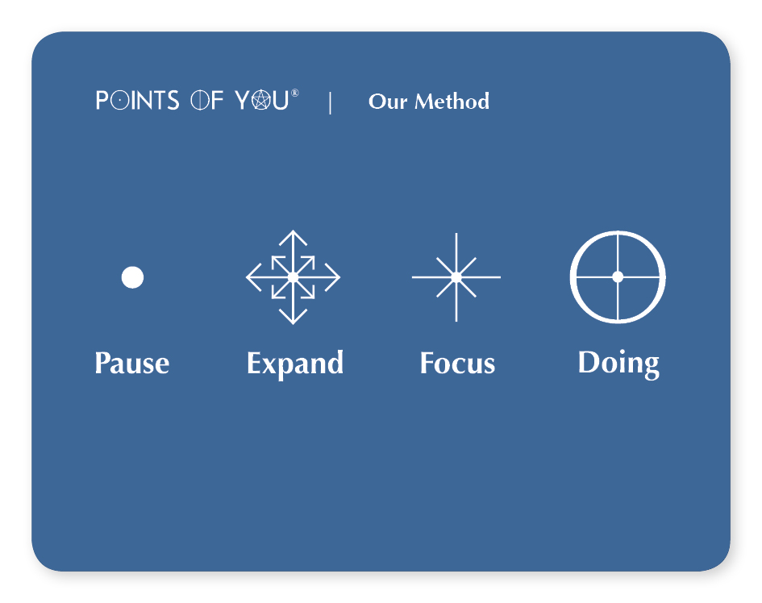
Facilitation
Our Method
(30 minutes)
Objectives
To understand the structure behind the experience
To implements the knowledge and techniques towards the Requirements
Process flow

Slide 28
Facilitation
Pausing is a mindfulness tool that helps us to take time out, to be in presence, to go into transitions easily… Pause will change our frequency from a hectic daily one to a slower one that helps us to observe deeply.

Slide 29
Facilitation
In every situation, there are countless points of view, the challenge is to observe life from a different one, and to see what we usually cannot see. In this step, we are searching for the unknown, without knowing where it will lead. This is a stage that opens us up for new thoughts/insights/ feelings/ observations… etc. It is about Everything is Possible.

Slide 30
Facilitation
After examining all the relevant points of view, we pick the most significant insight/ thought that we have, and we ground it. We clarify which of the options that pop up is the most relevant for us in the here and now and we pin it.

Slide 31
Facilitation
Doing is the stage when we shift from the potential to the concrete. We are taking it back to reality. We are asking the question - What can we do to take this insight into our life? Tachles!

Slide 32
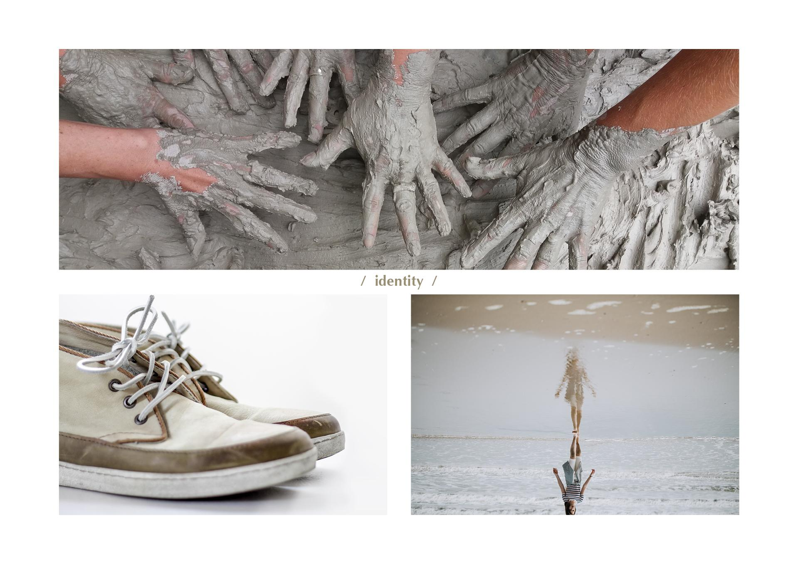
Facilitation
Our Method
(30 minutes)
Preparation
Music
None
Room setting This is after ‘on the stages’ process and we will organize the chairs back to a circle
Centerpiece with the ‘workshop cards’ (Why am I here)
Tools & Facilities 4 Method cards- which we hand to the participants Facilitators booklet- to read the 4 stages of our Method
Participant’s booklet
Our Method (page 72-73)

Slide 33
Facilitation
How to join our Tribe ?
(30 minutes)
Preparation
Music
None
Room setting This is after ‘our Method’ and ‘How to build a workshop’ processes the chairs are back in a circle
Centerpiece with the ‘workshop cards’ (Why am I here)
Tools & Facilities None
Participant’s booklet
Page… (Brochure?)

Slide 34
Facilitation
How to join our Tribe?
(30 minutes)
Facilitator’s focus – How to join our Tribe?
To give information about all Levels (towards 2020) To explain the requirements to become Experts
To point out the benefits of becoming Experts (Professional growth, business opportunity, leaders in community)
To make the session informative but exciting
Facilitator’s notes
Be familiar with all 4 Levels of the Academy and with the Requirements

Slide 35
Facilitation
How to join our Tribe?
(30 minutes)
Facilitation Content
Opening
objectives
Process flow
Points of You ® Academy L1- L.4 Requirements to become Experts
Closure
…

Slide 36

Facilitation
Points of You® Academy
Certification of Completion Titles
Once you complete all of the level's requirements
you receive a Certification of Completion Title:
Points of You® Academy
turns knowledge into profit.
As you climb up the ladder of Points of You® Academy certification levels, new business opportunities become available.
Certified Practitioners, Experts and Masters join the official Points of You® facilitation team in their region. Backed with a Points of You® Country Leader, our professional facilitation team receives ongoing marketing and business support, tailor- made for their needs.
L.1
L.2
L.3
L.4
L.3
Points of You®
Explorer
Points of You®
Practitioner
Points of You®
Expert
Points of You®
Master
Points of You® Certified facilitators
may facilitate the levels below
Level 2 Practitioner
Level 3 Expert
Level 4 Master
L.1
L.1
L.2
L.1
L.3
L.2

Slide 37

L.1 Hello Points Workshop- 6 hours
About the workshop
Welcome to the world of Points of You®.
In this exciting, one day workshop you will get a taste of the Points of You® methodology and tools, experience a unique form of communication and dialogue and add new skills to your professional know how.
Completing the Hello Points Workshop makes you a Points of You® Explorer.
This workshop is the first level of the Points of You® Academy.
As a facilitator, you will be opening a door for your participants to discover the magic of Points of You® tools and method, possibly for the first time.

Slide 38

L.2 Creative Practice Workshop-16 hours
About the workshop
This rhythmic workshop, decorated with our personal touch, is packed with both experiential and practical knowledge that will be easily integrated into daily professional use.
Get ready for 2 energetic days of diverse techniques for different target audiences, and a creative practice of three Points of You® tools - The Coaching Game, Punctum and Faces.
This workshop is the 2nd level of the Points of You® Academy.
As a facilitator, you will teach your participants the basics of our method, so that they can begin working with Points of You® tools on their own.

Slide 39

L.3 Turning Point Program -5 days
This workshop is the 3rd level of the Points of You® Academy.
Our method, make it yours
Discover multiple ways to integrate our tools with different audiences in 1:1 sessions and groups of different sizes.
About the workshop
Points of You® is a language, a way of life. Phototherapy, mindfulness, storytelling and music are just some of the engaging ways that you will explore on this 5 day program.
This is a chance to get a deep understanding of the Points of You® method and learn to speak our language fluently.
Experience a profound personal journey. Pause, breathe, nourish your body and heal your soul. Enjoy inspiring locations and beautiful people from around the world.

Slide 40
Experts Requirements
Requirements
Points of You®

Slide 41

L.4 Top View Program -7 days
This workshop is the 4th level of the Points of You® Academy. Our facilitators go through an enlightening journey of initiation and multiple facilitation experiences led by Points of You® co-founders and embraced by our leading masters until they complete the requirements and become a certified Master.
About the workshop
About the workshop
Once a year we select a small team of outstanding Experts from all over the world to participate in a one of a kind workshop.
Top View Program dives deep into the Points of You® DNA as a brand, as philosophy, as way of life. An uplifting experience of climbing up to the top of the mastery mountain of Points of You® facilitation.
This journey explores identity, presence, leadership, performance and a true calling.

Slide 42

Questions?

Slide 43

Closure

Slide 44

Thank You

